Slide 1
Welcome!
MiniPlay goes here.
‹#›

Slide 2
6.4 Advanced File Processing
PROFESSOR RAMSEY
GDC 6.318
ramsey@cs.utexas.edu

Slide 3
Announcements
TBD

Slide 4
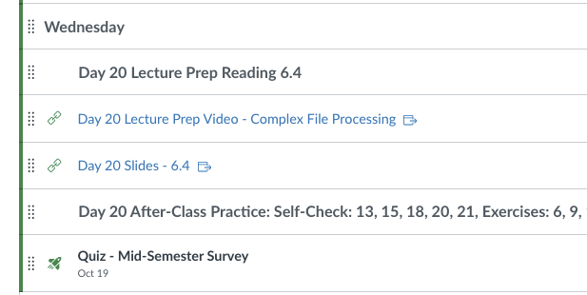
Mid-Semester Survey
The TAs and I want to know how it is going.
Each semester, course updates come from this survey.
Located in today’s module in Canvas.
Based on the Agile debrief practice.
Also includes survey about Imposter Syndrome.
Read the instructions to get an easy quiz grade.

Slide 5
6.3 Quiz

Slide 6
6.4
Advanced File Processing

Slide 7
Demo
Demo 1
What is happening?

Slide 8
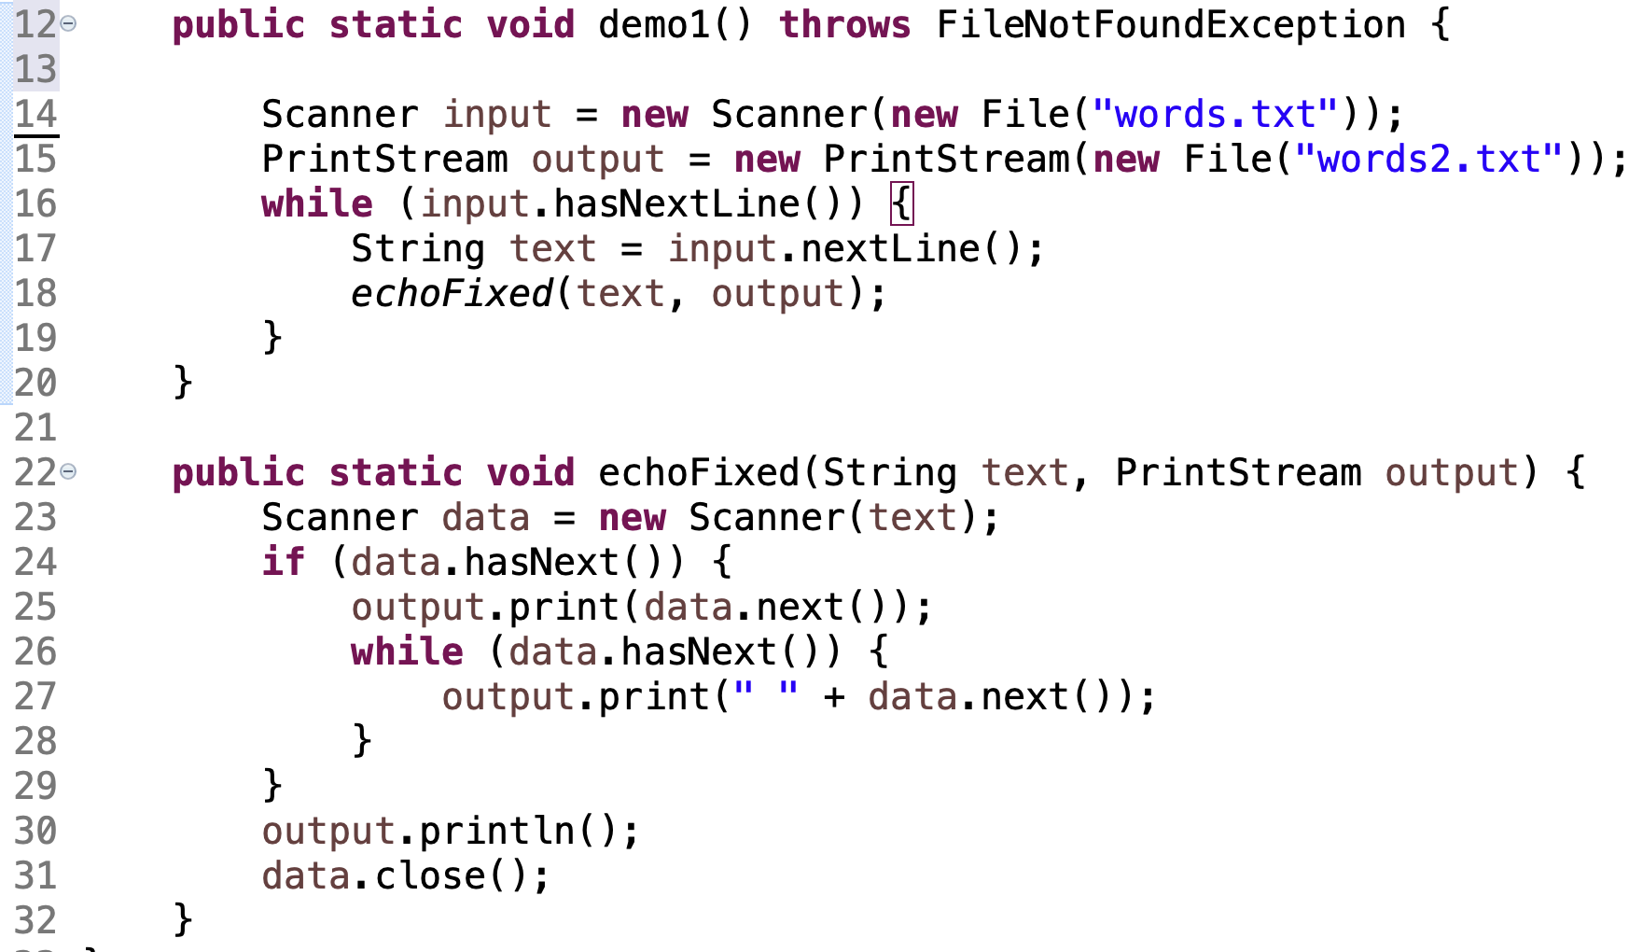
Demo Code

Slide 9
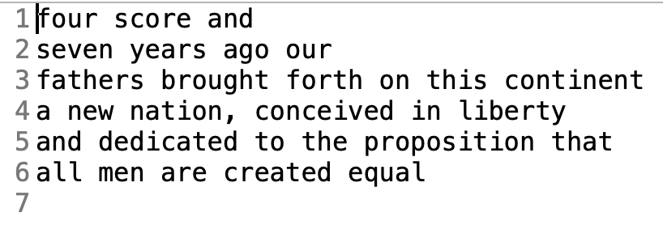
Mystery Solved
words.txt
words2.txt

Slide 10
File Output
PrintStream: An object in the java.io package that lets you print output to a destination such as a file.
Any methods you have used on System.out (such as print, println) will work on a PrintStream.
PrintStream name = new PrintStream(new File("file name"));
Example:
PrintStream output = new PrintStream(new File("out.txt"));
output.println("Hello, file!");
output.println("This is a second line of output.");

Slide 11
PrintStream Details
If the given file does not exist, it is created.
If the given file already exists, it is overwritten.
The output you print appears in a file, not on the console. You will have to open the file with an editor to see it.
Do not open the same file for both reading (Scanner) and writing (PrintStream) at the same time. This will overwrite your input file with an empty file (0 bytes).
All Scanners and PrintStreams - open and close one time.

Slide 12
Demo
Demo 2
Change Song Stats to print to a file.

Slide 13
Demo Code
Change this:
to this:

Slide 15
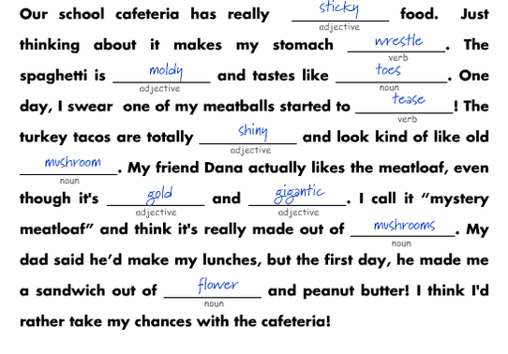
Mad Libs
Give me a:
adjective
verb
adjective
noun
verb
adjective
noun
adjective
adjective
noun
noun

Slide 16
Our Own Mad Lib
adjective
noun
adjective
noun; place
adjective
adjective
plural noun; vehicle
adjective
adjective
plural noun
plural noun
adjective
noun
verb
adjective
verb
plural noun
plural noun; type of job
adjective
verb
adjective

Slide 17
Demo 3 - Create Mad Lib
Use program to create Star Wars Mad Lib.
Review input and output files.
Review program structure.
(See next slide.)
Demo

Slide 18
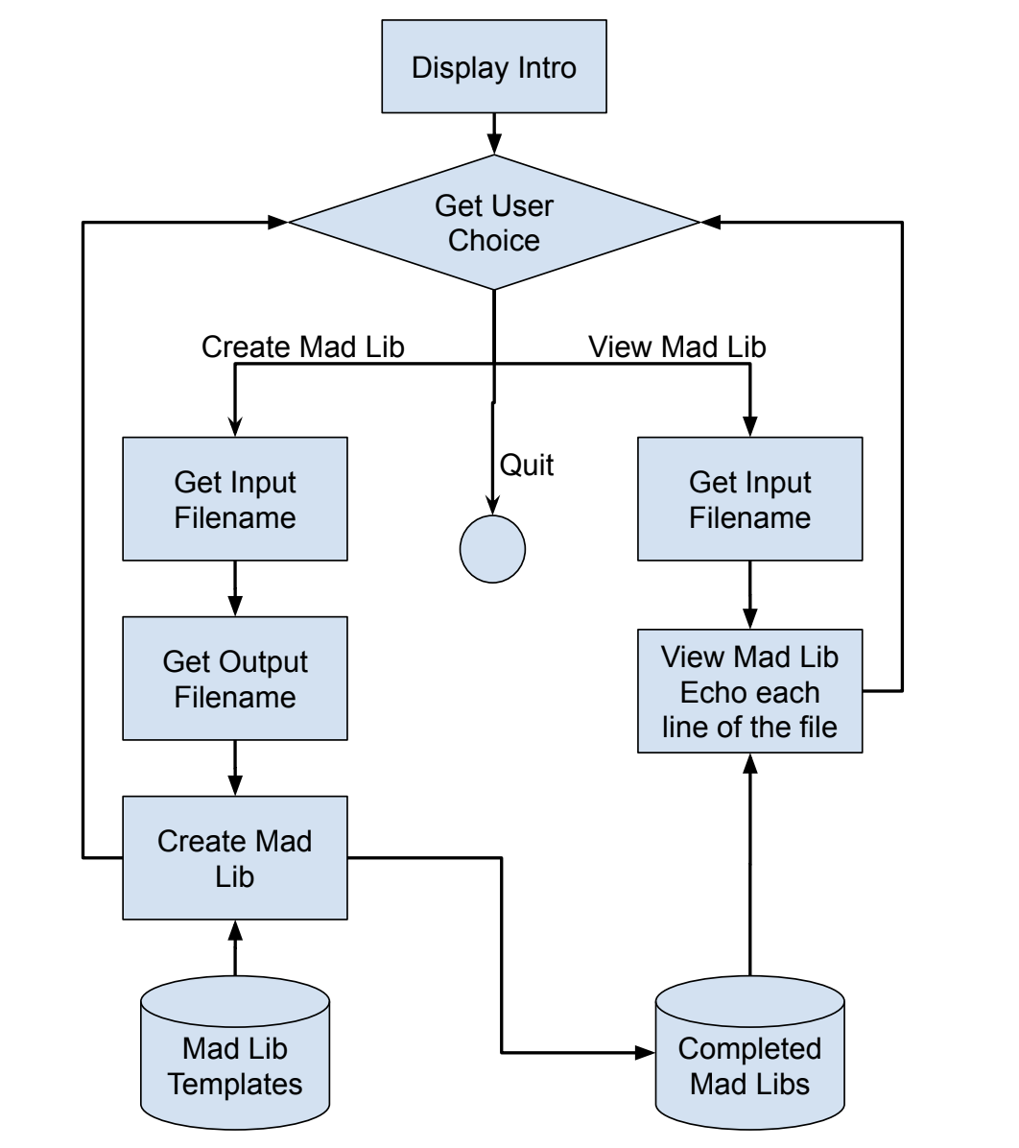
MadLib.java
(Questionable)
High-level design

Slide 19
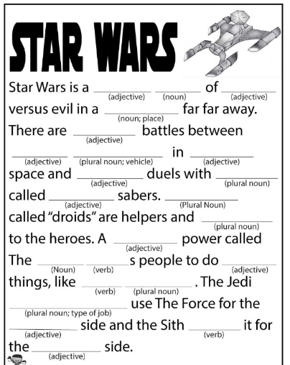

Slide 20
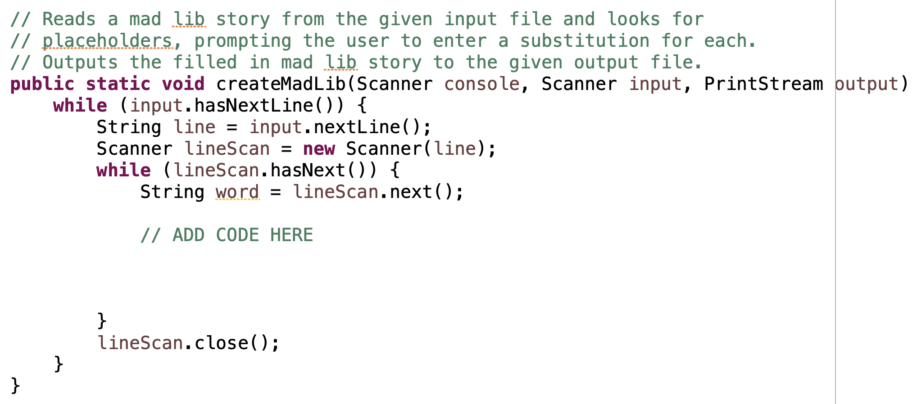
In-Class Practice
MadLibStart.java
finish createMadLib()
design on Doc Cam first

Slide 21
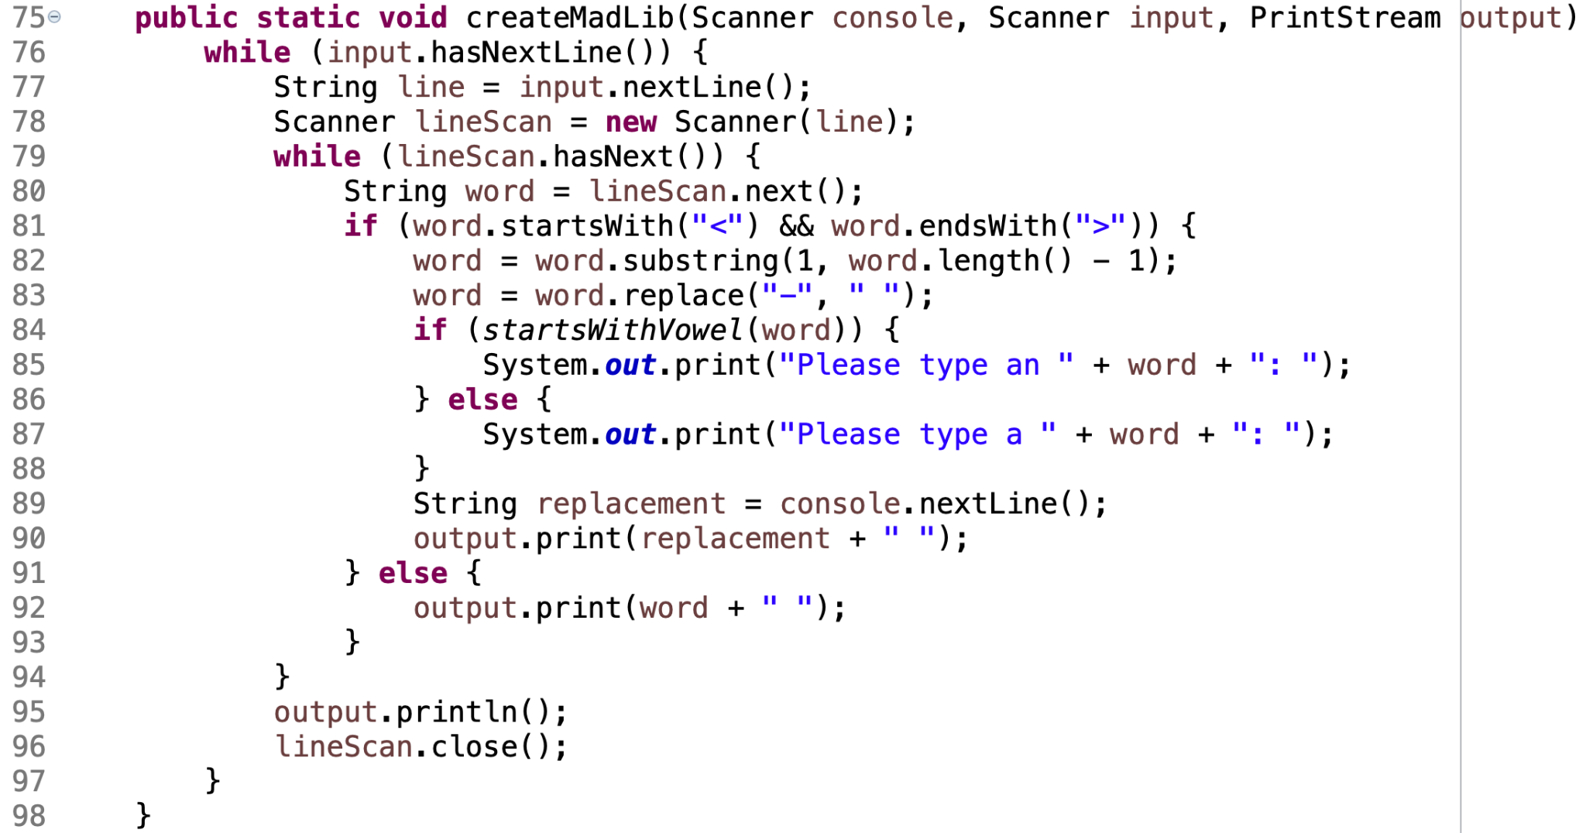
Solution

Slide 22
Remember
TBD
You Belong Here
Hi!

